Slide 1

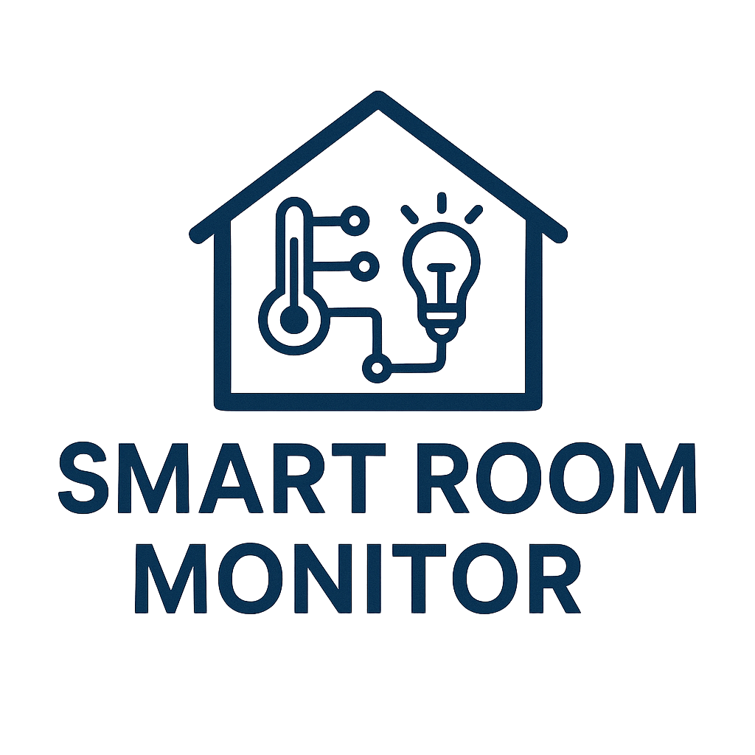
your all-in-one environmental sidekick
Stefano Corelli
Elisa Sterpu
Mattia Bernabè
Nicolas Venturi
Embedded Software for the Internet of Things

Slide 2
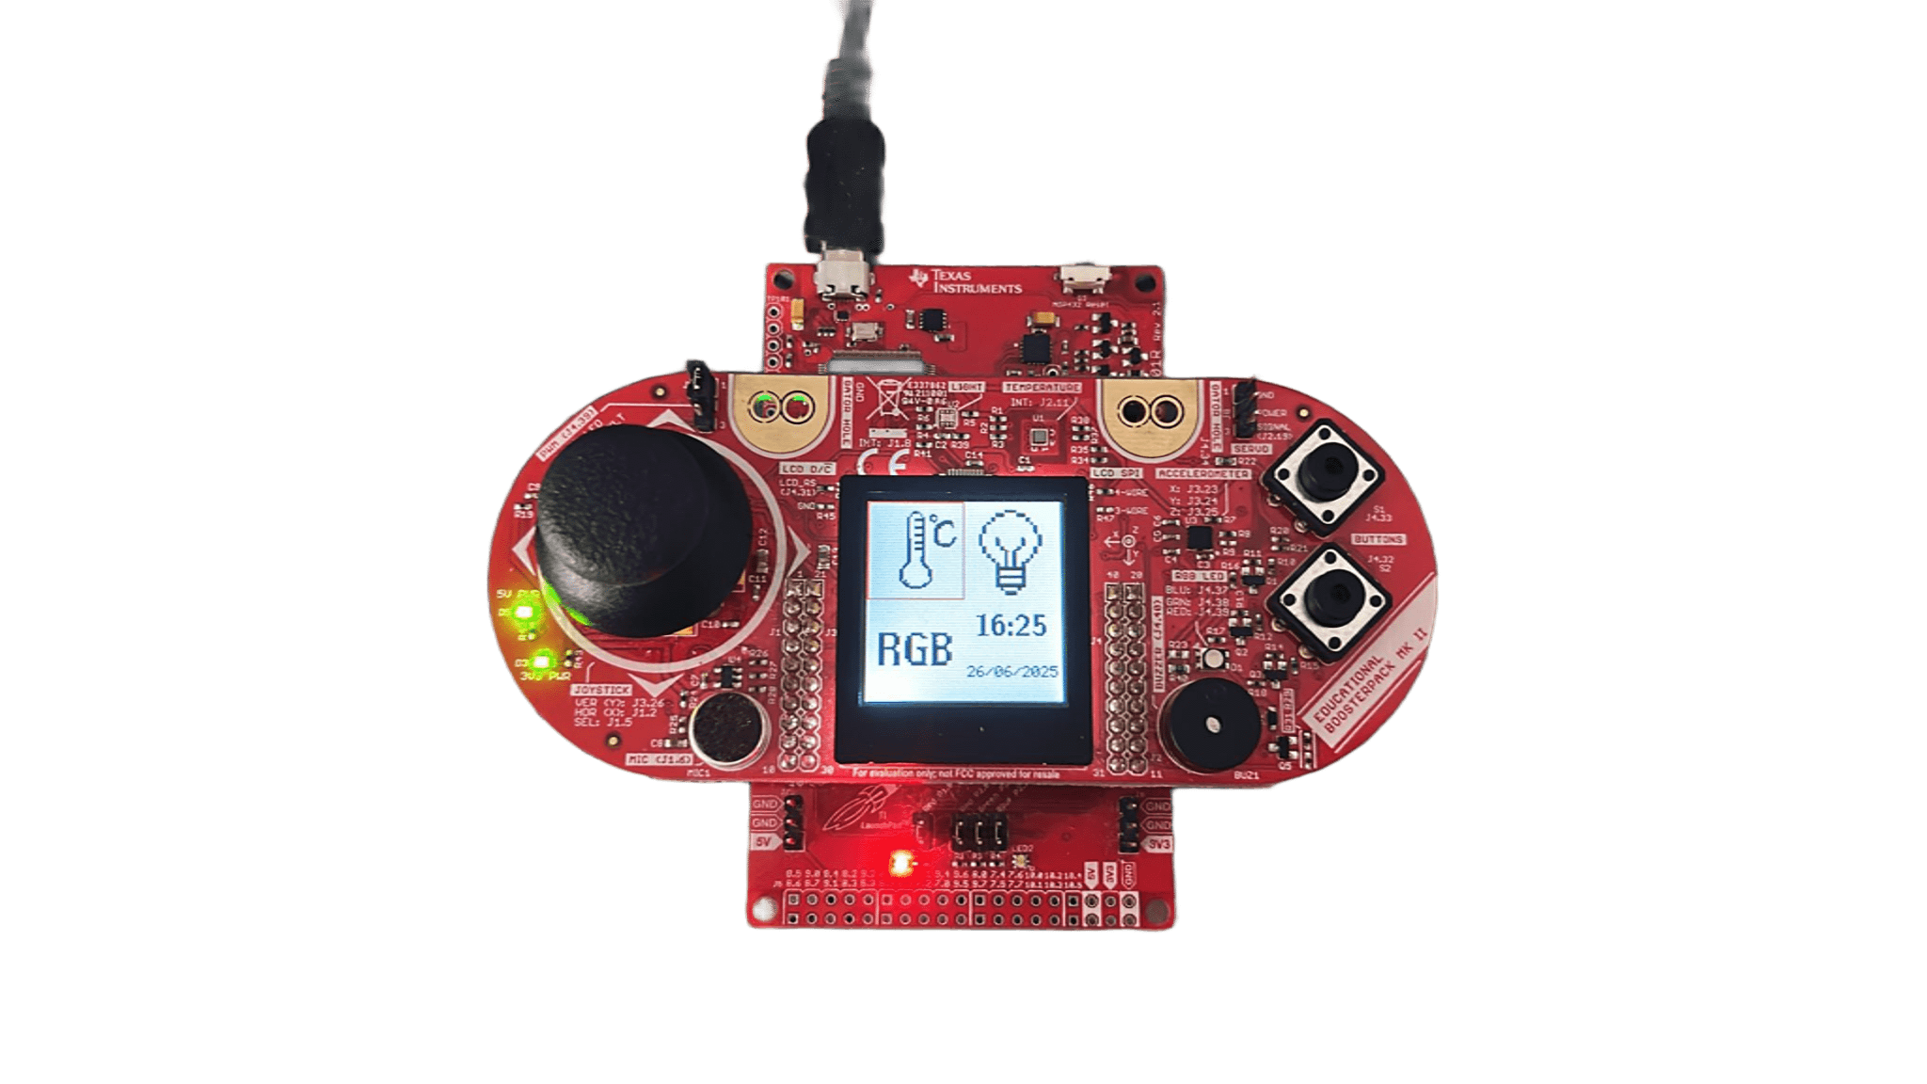
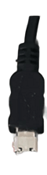
Introduction
Four easy-to-navigate modes
Ambient heat & clock
Light intensity & illumination mode
Safety alerts

Slide 3
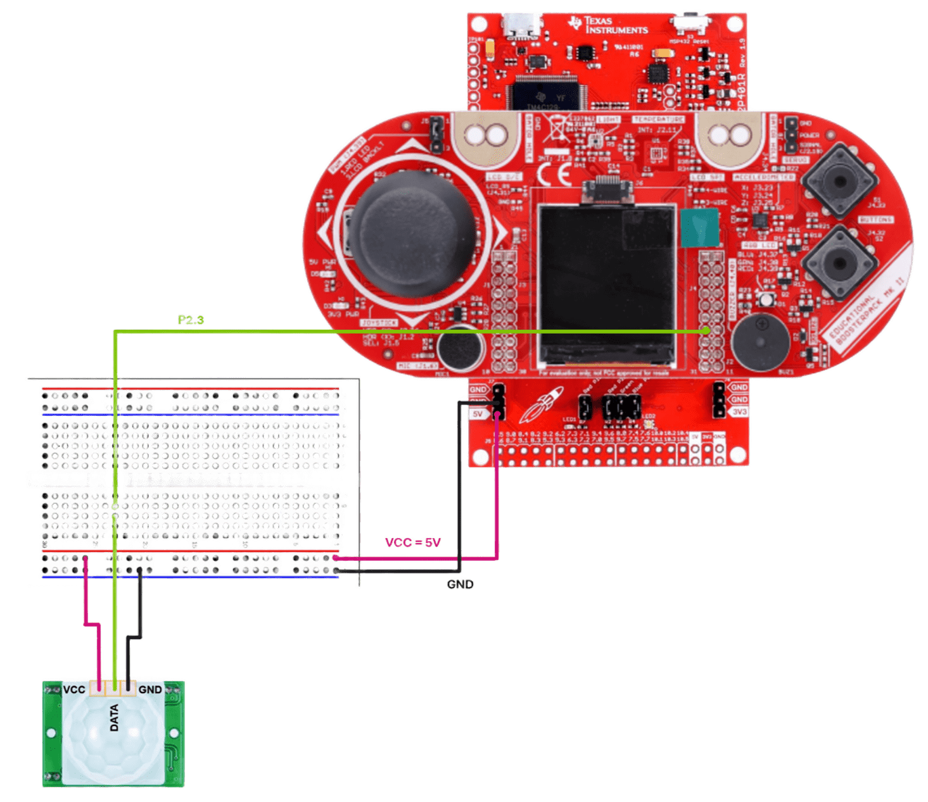
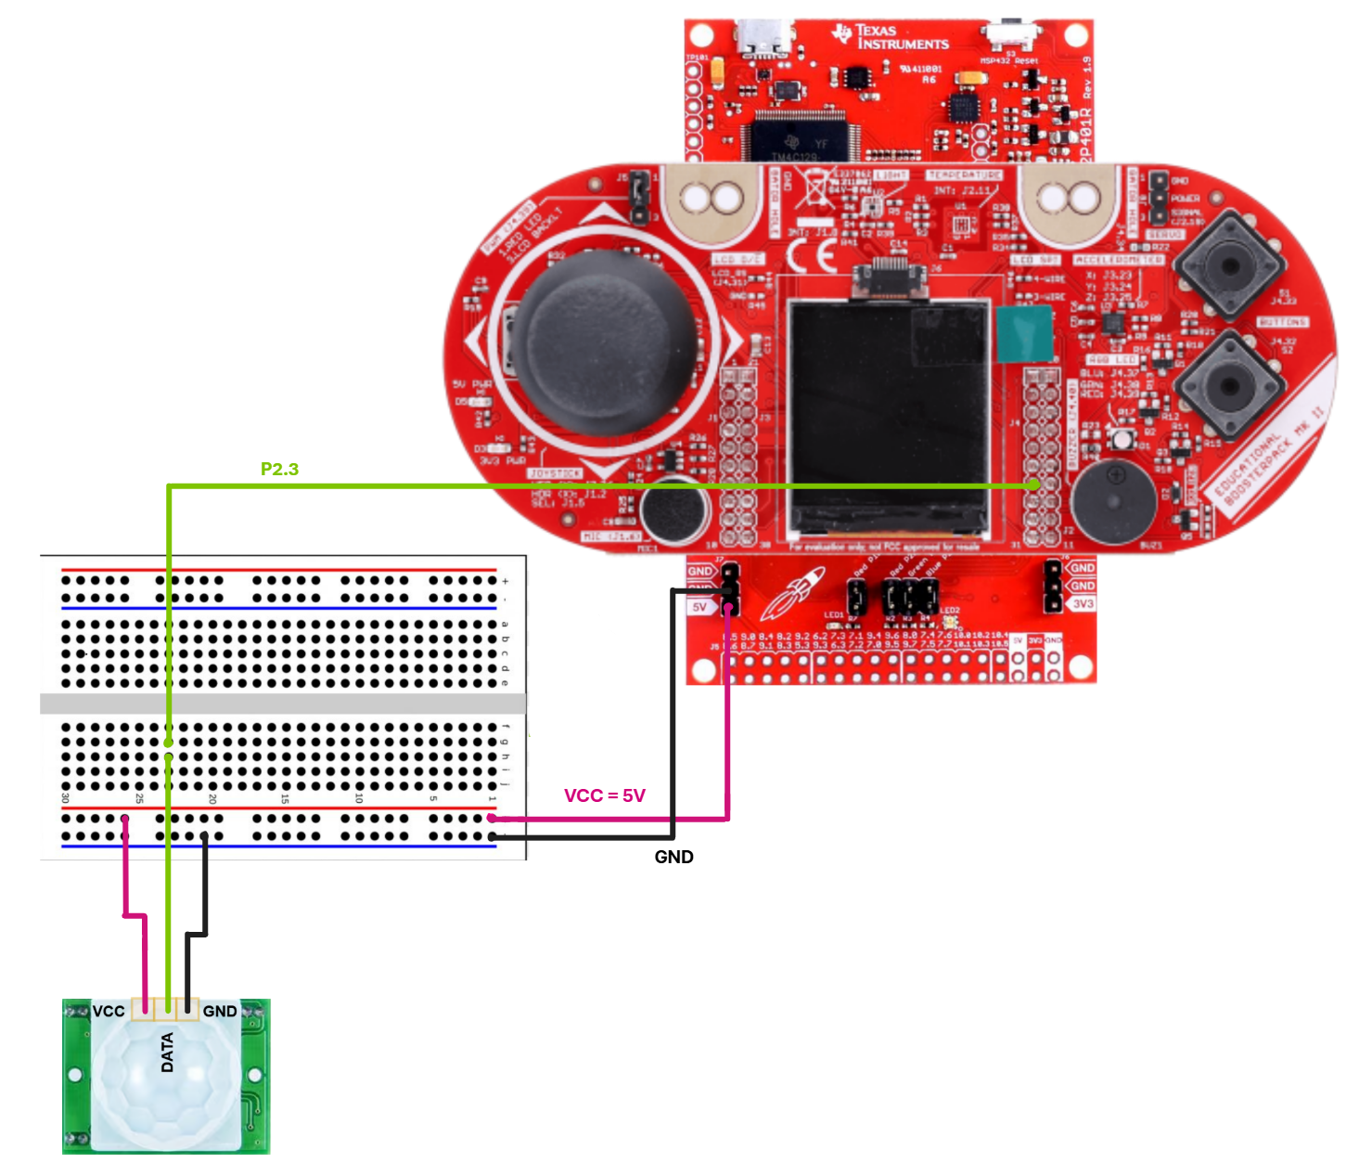
Software-Hardware Interaction
Select Button
Interactions buttons
Led 2:
Yellow – earthquake
Red – high temperature
Blu – low temperature
Led 1:
Movement detected
Pir

Slide 4
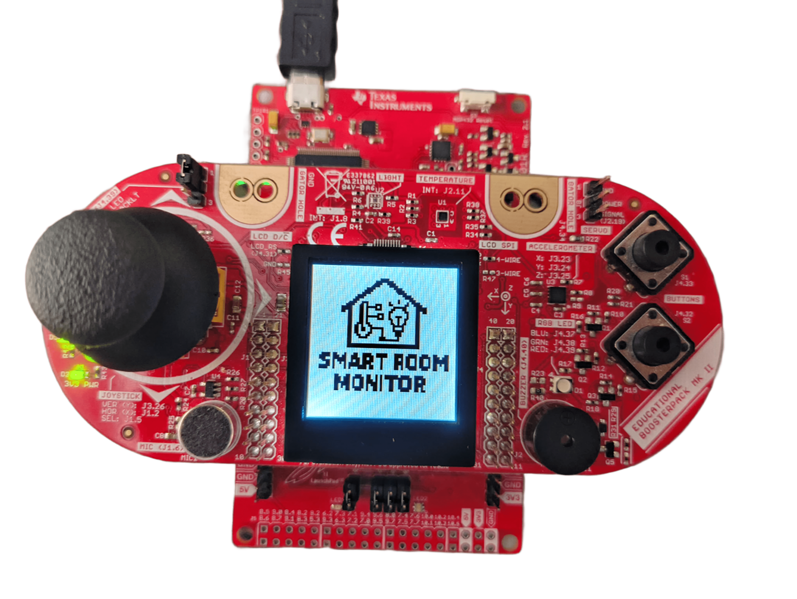
Software Architecture
Project Logo:
~3 sec then 4Q menu
4Q menu
Thermometer:
in Celsius
Light Sensor:
Light intesity
After 3 sec
RGB modifier:
select led color
Clock:
time modifier

Slide 5
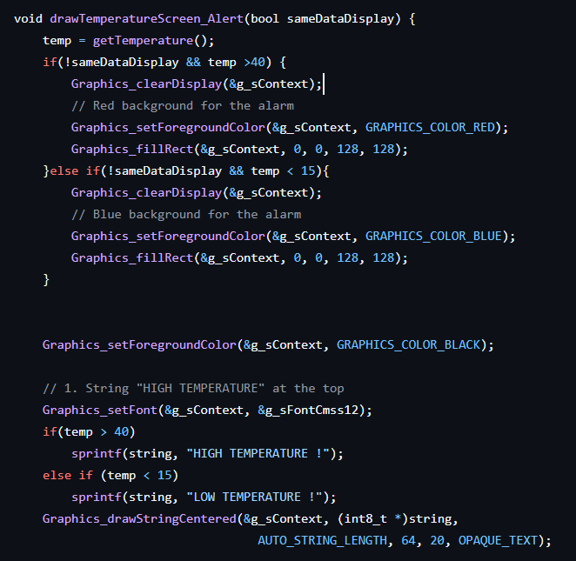
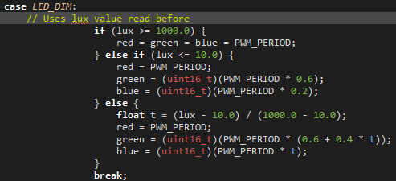
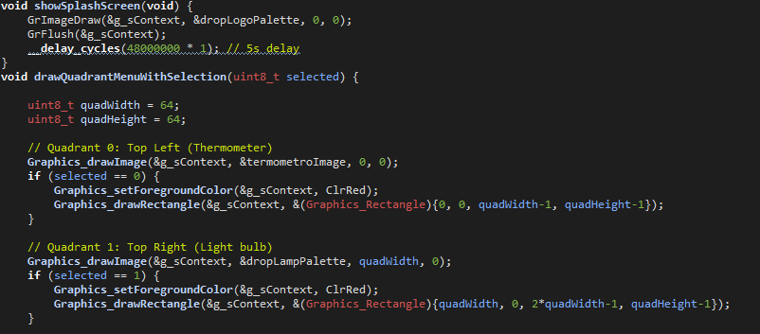
Every team member worked together and is responsible for the whole project
Code Snippets
Check lux value
Alarm Screen
4Q menu

Slide 6

Debug & Testing
Encountered problems:
Testing:
Accelerometer:
Motion when stationary:
Insufficient calibration
Electronic noise
Inappropriate threshold
Black-Box:
Each team member tested the software parts as black-box to ensure the result’s correctness.
Buzzer:
Set on timer A0 (same as red and green led)
Pir:
First used P6.4 instead of P2.3. (P6.4 is for I2C)

Slide 7
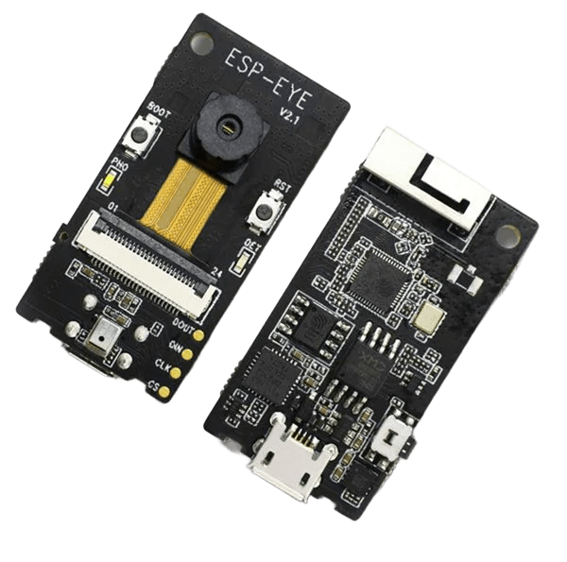




Future Upgrades
Onboard Battery Backup
Configurable PIR Hold‑Time in Firmware
ESP‑Powered Remote Connectivity

